Slide 1


<Name>
<Date>

Slide 2

Outline
Executive Summary
Introduction
Methodology
Results
Conclusion
Appendix
GitHub repo here: https://github.com/ThuyThiBird/Applied-Data-Science-Capstone.git

Slide 3
Executive Summary
The target of this project is to investigate the factors that affected the success of SpaceX missions, such as the payload, launch site, etc.
SpaceX data was obtained from SpaceX public API and from SpaceX launch data in Wikipedia. The desired data was extracted and transformed for Exploratory Analysis and visualization.
Various machine learning models were trained and tested (including logistics regression, support vector machines, decision trees, k-nearest-neighbors) in order to find the best model and the most accurate predictors of launch success
The decision tree model was the most accurate model among all
GitHub repo: https://github.com/ThuyThiBird/Applied-Data-Science-Capstone.git

Slide 4
Introduction
In this capstone, we will predict if the Falcon 9 first stage would land successfully. SpaceX adversities F9 rocket launches on its websites with the cost of around 62 M$ while other providers cost at least 165 M$ each, which is much of the savings as SpaceX can reuse the first stage.
To find the answers, we need to predict as close as possible if the first stage will be successful. From there we can determine the cost of a launch. This information can be used if an alternative company wants to compete with SpaceX for a rocket launch

Slide 5

Section 1

Slide 6
Methodology
Executive Summary
Data collection methodology:
SpaceX Public API and webscraping Wikipedia
Perform data wrangling
Handled Missing values as well as converted categorical variables into numeric features
Perform exploratory data analysis (EDA) using visualization and SQL
Perform interactive visual analytics using Folium and Plotly Dash
Perform predictive analysis using classification models
Standardize features, Split train test datasets, Use GridsearchCV to variable models to find the best models.

Slide 7
Data Collection – SpaceX API
Extract requested data
Requests.get(‘spacex_url’)
Decode response into a Pandas dataframe
pd.json_normalize(response.json())
Get the booster versions
getBoosterVersion(data)
Get Launch Site data
getLaunchSite(data)
Get Payload data
getPayLoadData(data)
Get Core Data
getCoreData(data)
https://github.com/ThuyThiBird/Applied-Data-Science-Capstone/blob/main/1.jupyter-labs-spacex-data-collection-api.ipynb

Slide 8
Data Collection - Scraping
Request to scrape data
Request URL
Get Content from the response
Create Soup Object from the response
Find Table headers
Find Each row in turn
Extract the data from each row and insert into a pandas frame
Save the dataframe to CSV
Applied-Data-Science-Capstone/2.jupyter-labs-webscraping.ipynb at main · ThuyThiBird/Applied-Data-Science-Capstone (github.com)

Slide 9
Data Wrangling
Handle Missing values
Identify all landing outcomes
Identify bad landing outcomes
Iterate through all bad landing outcomes
Failure: 0; Success: 1
Add new column as class for landing outcome
Save the dataframe to CSV
Applied-Data-Science-Capstone/labs-jupyter-spacex-Data wrangling.ipynb at main · ThuyThiBird/Applied-Data-Science-Capstone (github.com)

Slide 10
EDA with Data Visualization
We perform EDA using Matplotlib Visualization and Feature Engineering using Pandas
To be specific, we investigated the relationships between Flight number, Launch Site, Payload Mass & Orbit type using variable graphs styles, including scatter plots, bar chart, line charts.
The features were encoded using get_dummies() method, which converted categorical variables into binary features.
GitHub link: Applied-Data-Science-Capstone/4.jupyter-labs-eda-dataviz.ipynb at main · ThuyThiBird/Applied-Data-Science-Capstone (github.com)

Slide 11
EDA with SQL
Display unique values of launch sites in the space mission
Display 5 records where launch sites begin with ‘CCA’
Display the total payload mass carried by boosters launched by NASA
Display average payload mass carried by booster F9 v1.1
List the date where the first successful launching outcome in ground pad was achieved
List the name of boosters which have success in drone ship and have payload between 4000 and 6000
List the total number of successful and failure mission outcomes
List the names of the booster_versions which have carried the max payload
List the records which display the month names, failure landing outcomes in droneship, booster versions, launchsite for the months in 2015
Rank the count of successful landing outcomes between 4/6/2010 and 20/3/2017
GitHub link: Applied-Data-Science-Capstone/3.jupyter-labs-eda-sql-coursera_sqllite.ipynb at main · ThuyThiBird/Applied-Data-Science-Capstone (github.com)

Slide 12
Build an Interactive Map with Folium
Circles and markers were added to an interative Folium map to indicate launch locations
A markerCluster was added to visualize the launch outcome at each site, with color codes
A polyline was drawn between a launch site and another location (coast line, city, high way, metroline) to show the proximity of the two
GitHub link: Applied-Data-Science-Capstone/5.lab_jupyter_launch_site_location.ipynb at main · ThuyThiBird/Applied-Data-Science-Capstone (github.com)

Slide 13
Build a Dashboard with Plotly Dash
An interactive dashboard which allows users to investigate the effects of launch site, payload mass on the outcome (success or failure)
Launch site was made selectable from a dropdown menu and a range of payload is selectable using a slider control
Successful outcomes by launch sites are shown in a pie chart and How launch outcome varied by selected site and payload is shown is a scatter chart
GitHub link: Applied-Data-Science-Capstone/6.Spacex_dash_app.py at main · ThuyThiBird/Applied-Data-Science-Capstone (github.com)

Slide 14
Predictive Analysis (Classification)
Standardize data
Split data into train and test data
Create a GridSearchCV function with logistics regression and find the best params
Create a GridSearchCV function with SVM and find the best params
Create a GridSearchCV function with Decision Trees and find the best params
Create a GridSearchCV function with logistics KNN and find the best params
Choose the best models with highest accuracy score (Decision Trees)
Applied-Data-Science-Capstone/7.SpaceX_Machine Learning Prediction_Part_5.ipynb at main · ThuyThiBird/Applied-Data-Science-Capstone (github.com)

Slide 15
Results
 | Logistics Regression | Support vector machines | Decision Tree | KNN
Training score (best params) | 0.845 | 0.848 | 0.888 | 0.848
Testing score (best params) | 0.833 | 0.833 | 0.889 | 0.833

Slide 16

Section 2

Slide 17
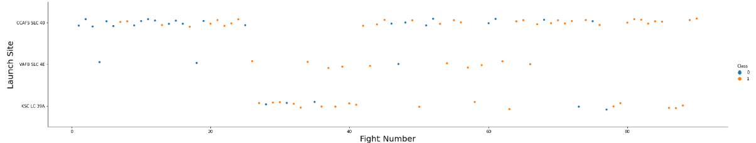
Flight Number vs. Launch Site
CCAFS SLC 40 had more tests, however, success rate is lower vs the other 2

Slide 18
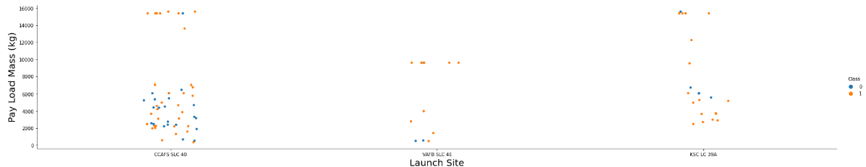
Payload vs. Launch Site
Launches with heavier payload were more successful

Slide 19
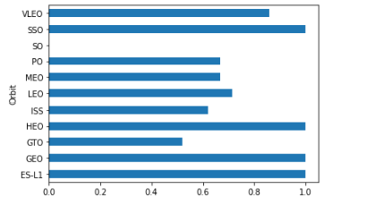
Success Rate vs. Orbit Type
Orbit type SO has 0% success rate
Orbit type SSO, HEO, GEO, ES-L1 are 100% successful

Slide 20
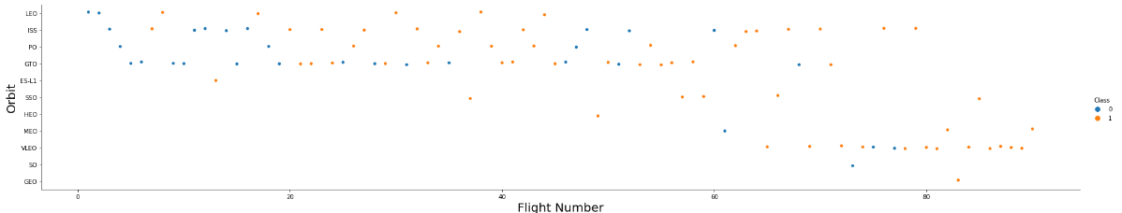
Flight Number vs. Orbit Type
In all Orbit types, success rate increases when the number of flights increases

Slide 21
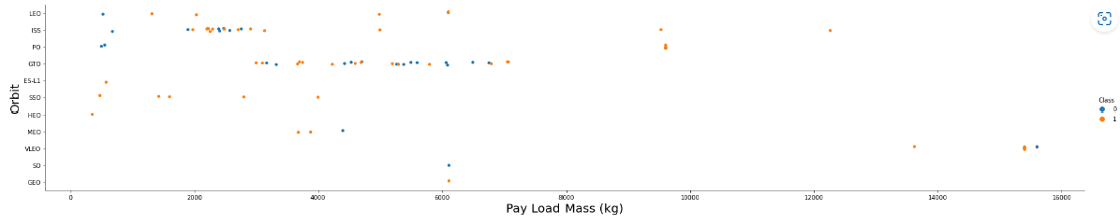
Payload vs. Orbit Type
No clear patterns

Slide 22
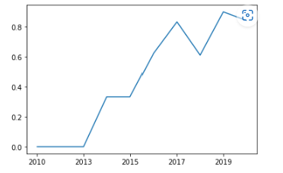
Launch Success Yearly Trend
Success rate increases by the time

Slide 23
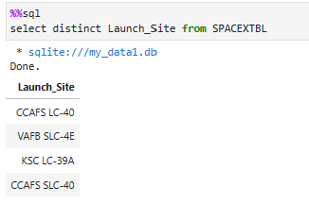
All Launch Site Names
Using Select distinct

Slide 24
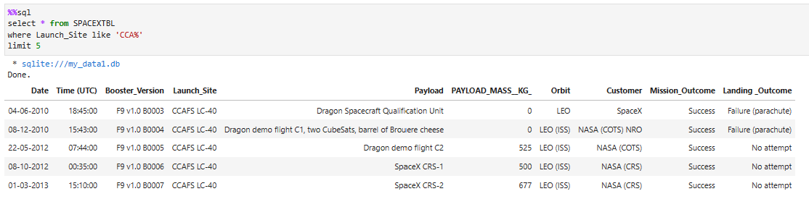
Launch Site Names Begin with 'CCA'
Using like ‘%A%’ and limit 5

Slide 25
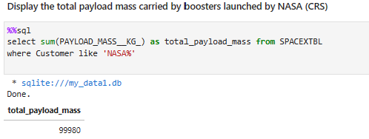
Total Payload Mass
Using sum function with filter using like

Slide 26
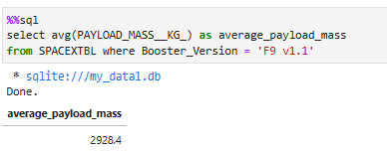
Average Payload Mass by F9 v1.1
Using average function

Slide 27
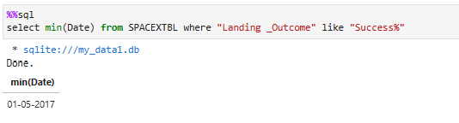
First Successful Ground Landing Date
Using min function and filter with like

Slide 28
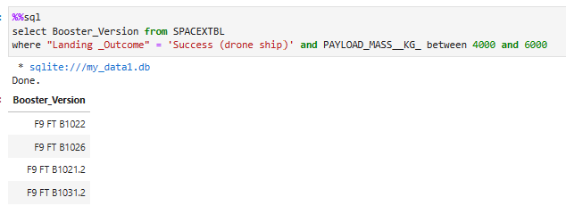
Successful Drone Ship Landing with Payload between 4000 and 6000
Using filter with between

Slide 29
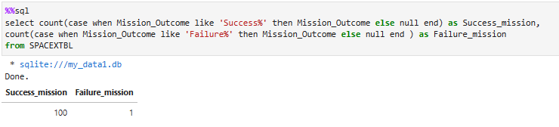
Total Number of Successful and Failure Mission Outcomes
Using count with case when to filter

Slide 30
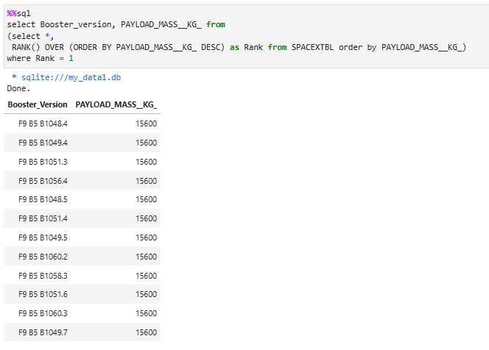
Boosters Carried Maximum Payload
Using rank() over in sub query

Slide 31
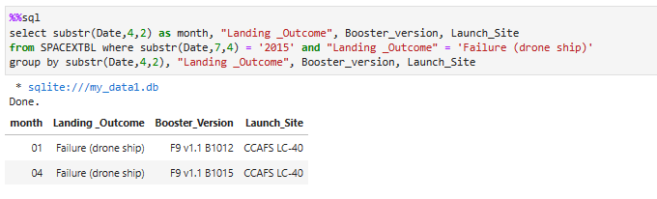
2015 Launch Records
Using substr() to get month and group by

Slide 32
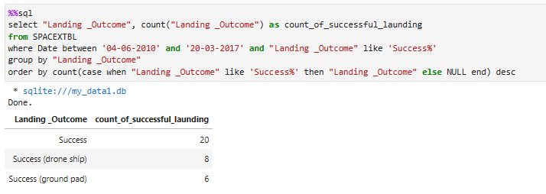
Rank Landing Outcomes Between 2010-06-04 and 2017-03-20
Using order by to get the outcomes by descending order

Slide 33

Section 3

Slide 34
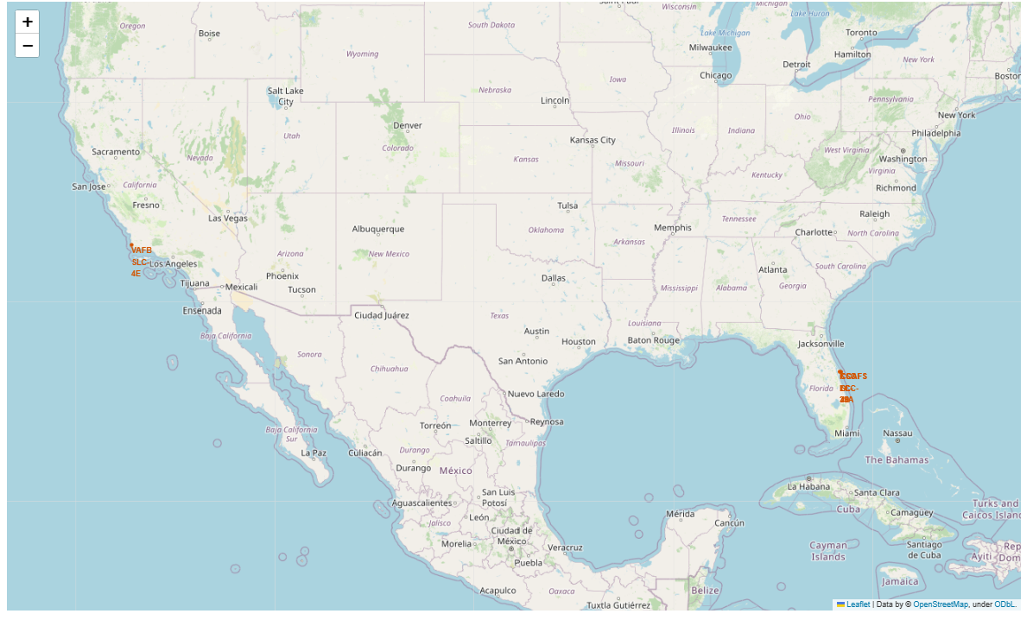
Mark the launching sites
Mark and Circle 4 launching sites

Slide 35
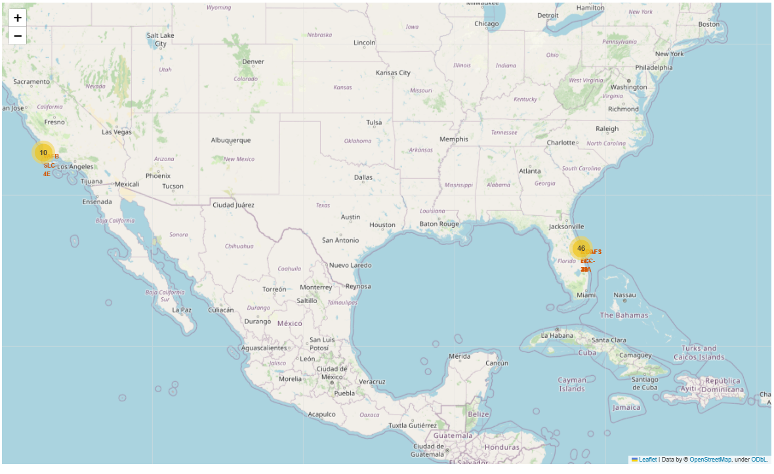
Mark success/failed launches
Mark success and failed launches in each launching site with color coding of success (green) and failure (red)

Slide 36
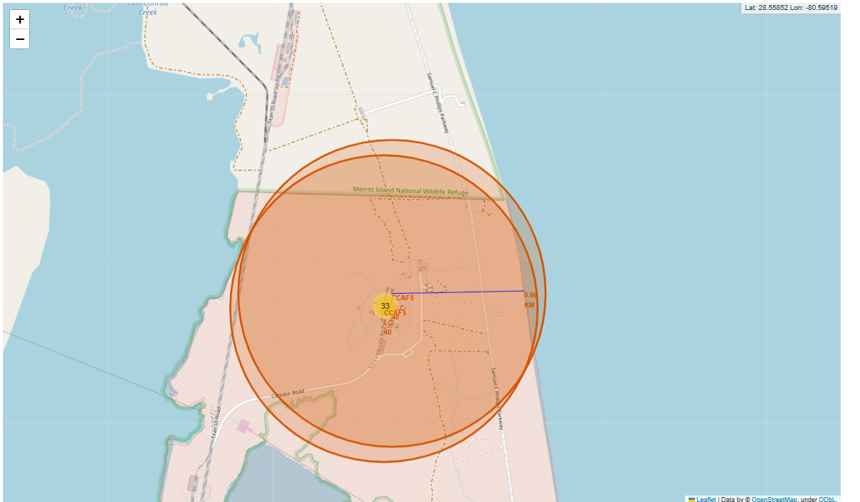
Distance between a launch site to its proximities
Pop up the distance in KM and draw a line between the launch site to the measured location

Slide 37

Section 4

Slide 38

Dropdown menu to choose a launch site
This allows users to choose a launch site or all launch sites to get interactive results

Slide 39
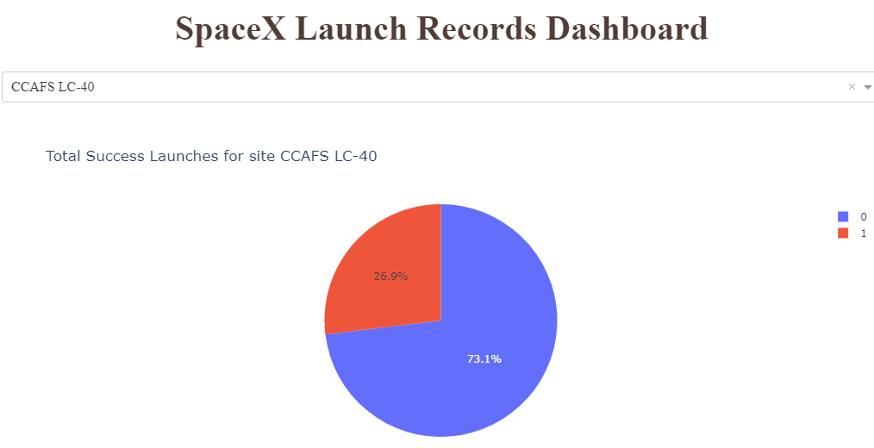
Pie chart of Success launches
Total success launch for 1 site

Slide 40
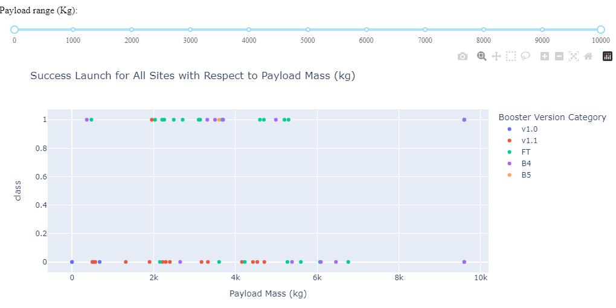
Scatter plot of Success launches with respect to site and payload
Success launch by site and payload

Slide 41

Section 5

Slide 42
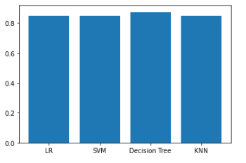
Classification Accuracy
Decision Tree has the highest accuracy

Slide 43
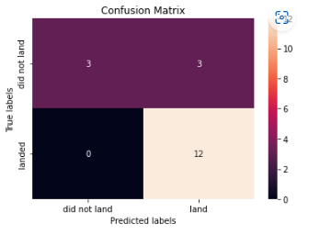
Confusion Matrix
3 Launches did not land and were predicted to have launched
12 launches which landed where predicted correctly to land
15/18 launches were predicted correctly to launch or not launch

Slide 44
Conclusions
Decision Tree give the best accurate forecast

Slide 45
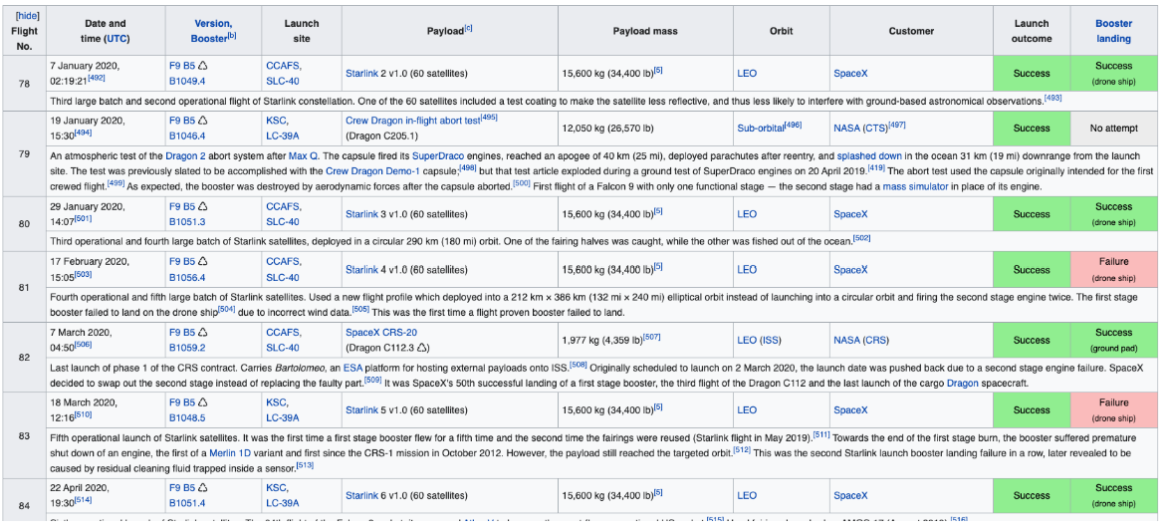
Appendix

Slide 46


